Slide 1

Software Engineering
Introduction to Software Engineering
Department of Computer Science and Engineering
Acknowledgement: Dr. Phalachandra HL, authors of the prescribed textbooks and materials sourced online.

Slide 2

Software Engineering
SDLC, PDLC, PMLC, SMLC, Product Lifecycle
Department of Computer Science and Engineering

Slide 3
General Principles in Software Engineering
David Hooker has proposed seven principles that focus on software engineering practice as a whole.
The Reason It All Exists
KISS (Keep It Simple, Stupid!)
Maintain the Vision
What You Produce, Others Will Consume
Be Open to the Future
Plan Ahead for Reuse
Think!
Reference to Textbook Pages

Slide 4
Seven Principles of Software Engineering Practice
1. The Reason It All Exists
Understand and prioritize the end-user's needs. Software should provide value to its users.
2. KISS (Keep It Simple, Stupid!)
Simplicity in design and implementation. Avoid unnecessary complexity.
3. Maintain the Vision
Consistent direction throughout the project. Ensure all team members understand and follow the project's vision.
4. What You Produce, Others Will Consume
Consider the future users and maintainers of your code. Write clear, understandable, and maintainable code.

Slide 5
Seven Principles of Software Engineering Practice
5. Be Open to the Future
Design software that can adapt to future changes. Plan for scalability and flexibility.
6. Plan Ahead for Reuse
Design with reusability in mind. Create components that can be reused in other projects or contexts.
7. Think!
Critical thinking and problem-solving. Always consider the implications of your decisions.
Source: https://wiki.c2.com/?SevenPrinciplesOfSoftwareDevelopment=

Slide 6
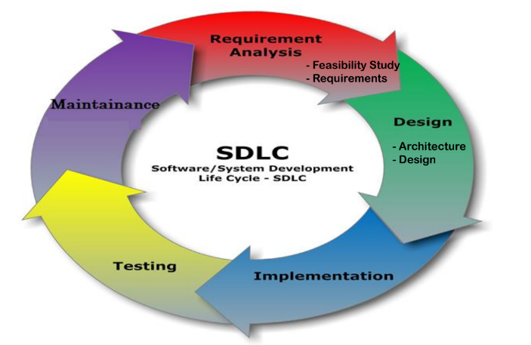
Software Development Lifecycle – SDLC
It is a structured set of planned activities/phases producing intermediate or final products.
A systematic approach that generates a structure for the developer to design, create and deliver high-quality software based on customer requirements and needs.
The primary goal of the SDLC process is to produce cost-efficient and high-quality products.
Source: https://www.betsol.com/blog/7-stages-of-sdlc-how-to-keep-development-teams-running/

Slide 7
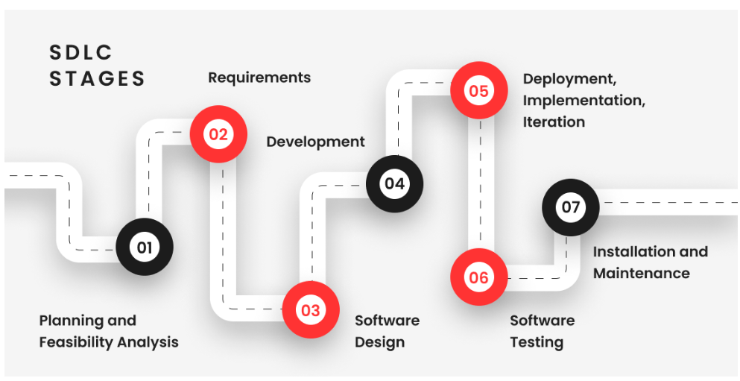
SDLC — Why to use?
Some benefits of using an SDLC during development:
It gives a clear plan of action and ensures transparency.
Avoiding pitfalls and bottlenecks helps in faster delivery and meeting deadlines.
Estimates the cost of each phase of the project, focusing on the time, tools, and other resources needed.
A well-structured SDLC leads to higher customer satisfaction
Source: https://qarea.com/blog/software-development-life-cycle-guide

Slide 8
SDLC — Stages
Stage 1 - Project Planning:
The first stage of SDLC is all about “What do we want?” Project planning is a vital role in the software delivery lifecycle since this is the part where the team estimates the cost and defines the requirements of the new software.
Stage 2 - Gathering Requirements & Analysis:
Next, we gather maximum information from the client requirements for the product. Discuss each detail and specification of the product with the customer. The development team will then analyze the requirements keeping the design and code of the software in mind. The main goal of this stage is that everyone understands even the minute detail of the requirement (hardware, operating systems, programming, and security etc)
Stage 3 - Design:
The program developer checks whether the prepared software suffices all the requirements of the end-user and if the project is feasible for the customer technologically, practically, and financially.

Slide 9
SDLC — Stages (Continued)
Stage 4 - Implementation: Translating the design to a computer-legible language. The tasks are divided into modules/units and assigned to various developers who then start building the entire system using programming languages.
Stage 5 - Testing: Once built, software is deployed in the testing environment to test functionality to ensure that the entire application works according to the customer requirements.
Stage 6 - Deployment: Software is released for customers to use. The size of the project determines the complexity of the deployment. The users are then provided with the training or documentation that will help them to operate the software.
Stage 7 - Maintenance: The actual problem starts when the customer actually starts using the developed system and those needs to be solved from time to time. This stage is where the developed product is taken care of.

Slide 10
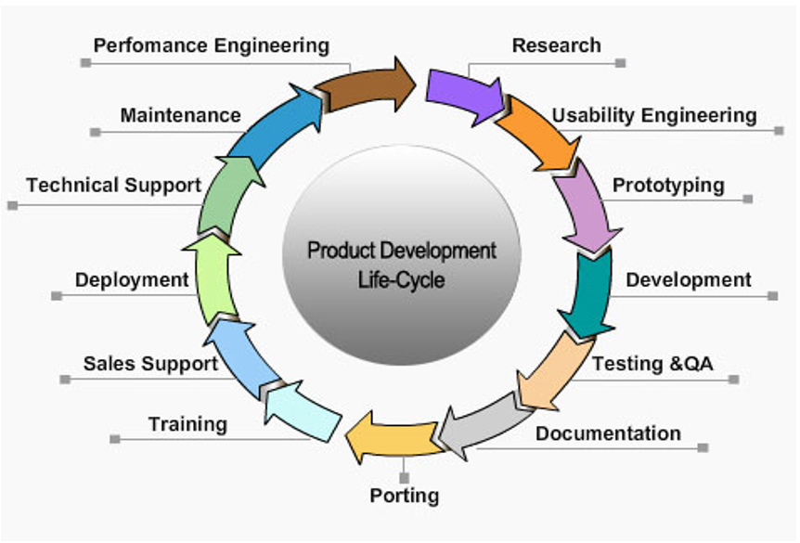
Product Development Lifecycle – PDLC
The specific set of steps to take a project from first spark to release.

Slide 11
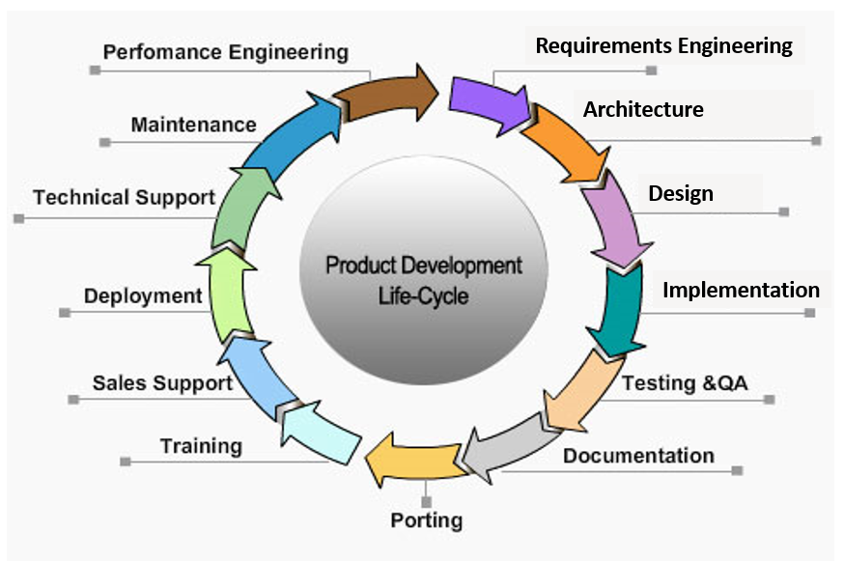
Product Development Lifecycle – PDLC
Variation 2

Slide 12
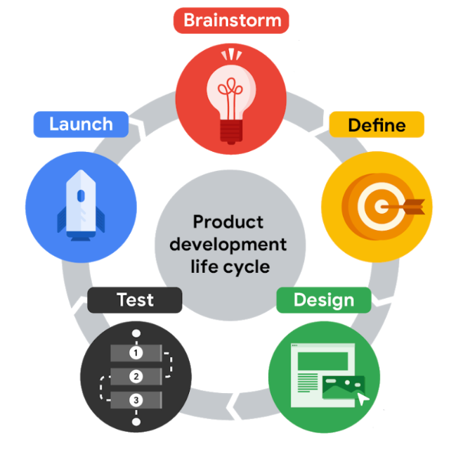
Product Development Lifecycle – PDLC
Variation 3
Brainstorm stage is when the team starts thinking of an idea for a product.
In the Define stage the goal is to figure out the specifications for the product by answering questions like: Who is the product for? What will the product do? And, what features need to be included for the product to be successful?
In the Design stage you start by drawing wireframes, which are outlines or sketches of the product, then move on to creating prototypes, which are early models of a product that convey its functionality.
The Test stage means writing the code and finalizing the overall structure of the product.
The launch stage is when the product is released into the world.

Slide 13
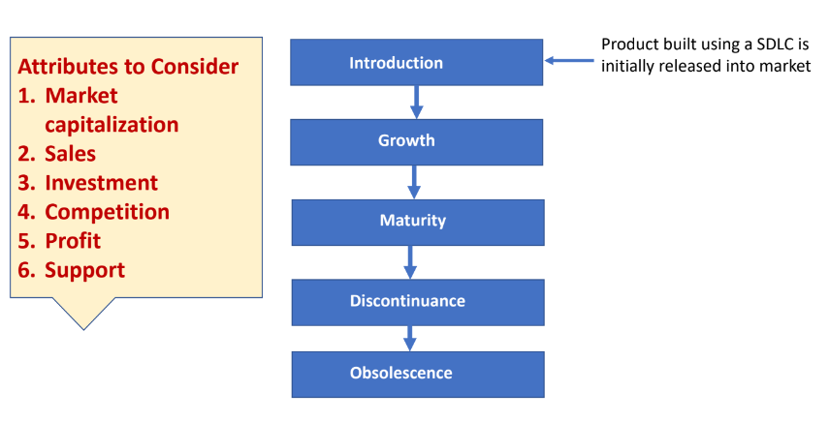
Product Lifecycle
A product life cycle is the length of time from a product first being
introduced to consumers until it is removed from the market.
Source: https://www.investopedia.com/terms/p/product-life-cycle.asp

Slide 14
Product Lifecycle
Introduction: This phase generally includes a substantial investment in advertising and a marketing campaign focused on making consumers aware of the product and its benefits.
Growth: If the product is successful, it then moves to the growth stage, characterized by growing demand and increase in production.
Maturity: This is the most profitable stage, while the costs of producing and marketing decline.
Decline: A product takes on increased competition as other companies emulate its success—sometimes with enhancements or lower prices. The product may lose market share and begin its decline.

Slide 15
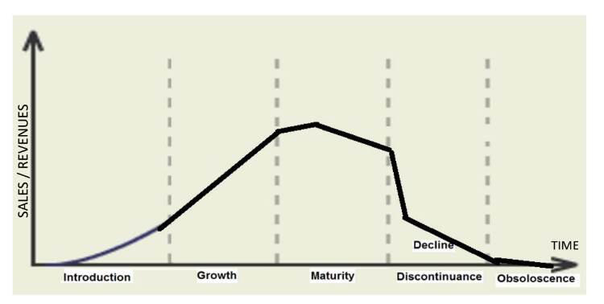
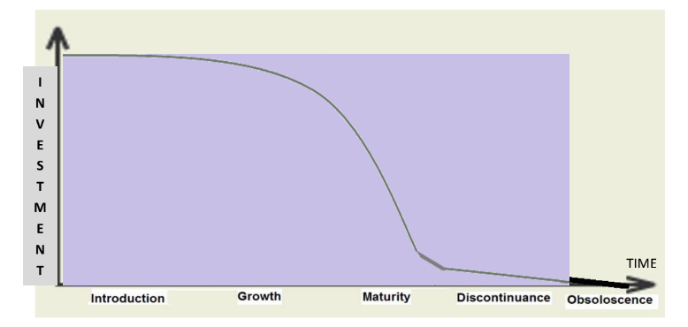
Product Life Cycle Characteristics

Slide 16
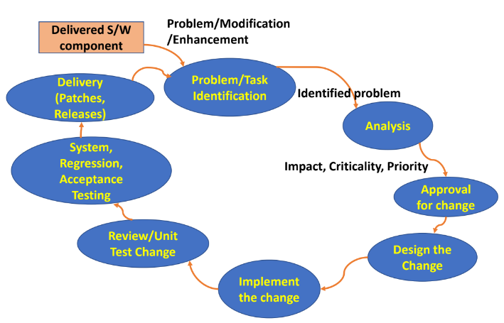
Software Maintenance Lifecycle – SMLC
Refer: https://www.simform.com/blog/software-maintenance/
Will be covered in future unit lectures.

Slide 17
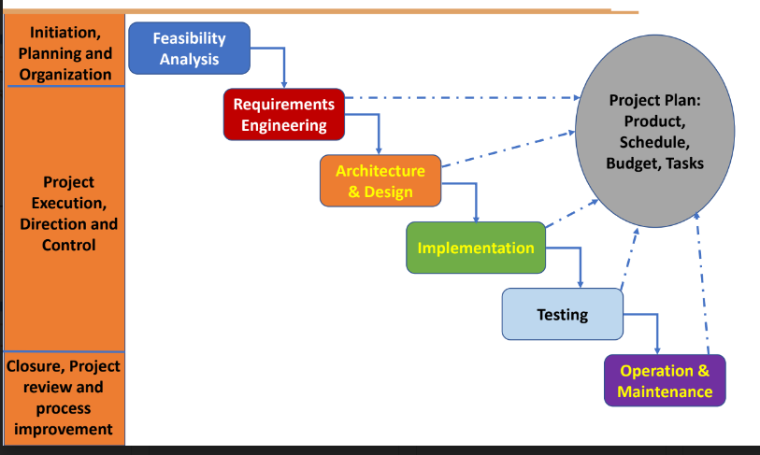
Project Management in System Development Life Cycle – PMLC

Slide 18
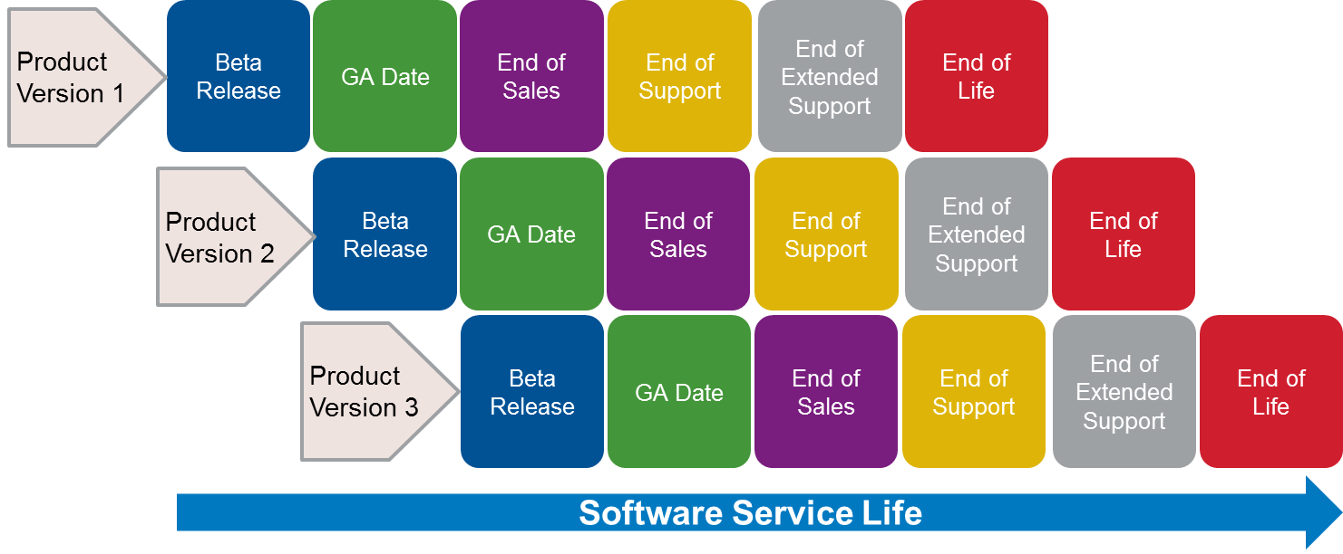
Software Support Lifecycle

Slide 19
THANK YOU
Department of Computer Science and Engineering

